Slide 1
How to manipulate the sorting of characters with diacritics in Analytics
Yoel Kortick – Senior Librarian

Slide 2

Contents
  Introduction
  The situation now
  The formula to change the sort (option one)
  The report with the new formula (option one)
  Check the report with the new sorting (option one)
  The formula to change the sort (option two)
  The report with the new formula (option two)
  Check the report with the new sorting (option two)

Slide 3
Introduction

Slide 4
Introduction
There are sometimes situations where strings of characters have diacritics, and this influences the sorting of the characters in Analytics.
This is specifically prevalent in the names of users.
For example, the last name “Śkywalker” will sort after “z” because the “Ś” (with a diacritic) will sort at the end of the Latin alphabet.
This is not necessarily “wrong”, but it can in any case be changed using a formula.

Slide 5
The situation now

Slide 6
The situation now
Let’s take a look at these 8 examples of users as they appear in the “Last Name” in the “User Details” folder of the “Users” subject area:
  Ątkins
  Ęlber
  Śkywalker
  Ćool
  Łewis
  Ńieve
  Ólmedo
  Źagger

Slide 7
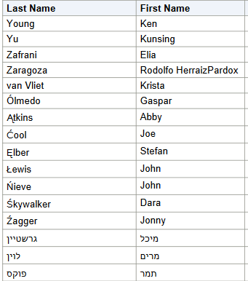
The situation now
The 8 Last Names which have the diacritics are sorted after the entire Latin alphabet:

Slide 8

The situation now
In option one, we want this
To be sorted here

Slide 9

The situation now
In option one, we want this
To be sorted here

Slide 10

The situation now
In option one, we want this
To be sorted here

Slide 11

The situation now
In option one, we want this
To be sorted here

Slide 12

The situation now
In option one, we want this
To be sorted here

Slide 13

The situation now
In option one, we want this
To be sorted here

Slide 14

The situation now
In option one, we want this
To be sorted here

Slide 15

The situation now
In option one, we want this
To be sorted here

Slide 16
The formula to change the sort (option one)

Slide 17
The formula to change the sort (option one)
We will use this formula:
Evaluate('TRANSLATE(%1,%2,%3)',"User Details"."Full Name",'ĄąĆćĘęŁłŃńÓóŚśŹźŻż', 'AaCcEeLlNnOoSsZzZz')
This means:
  Ą will sort as A
  ą will sort as a
  Ć will sort as C
  ć will sort as c
  Ę will sort as E
Etc.
Note that if you copy and paste this formula make sure the quotation marks do not get “ruined”. They may need to be retyped manually.

Slide 18
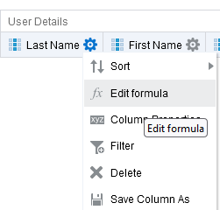
The formula to change the sort (option one)
In the criteria tab, on the last name, let’s edit the formula

Slide 19
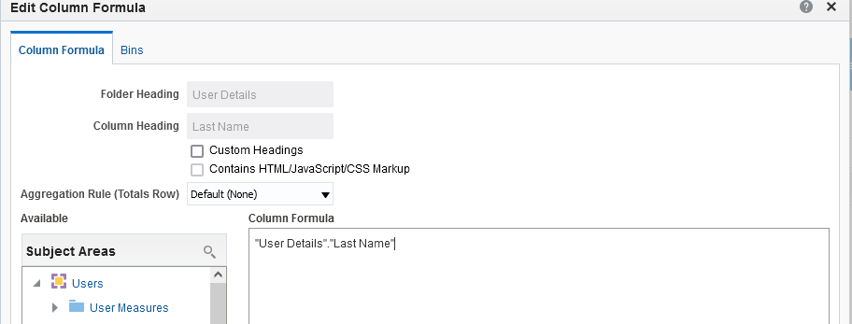
The formula to change the sort (option one)
Instead of this

Slide 20
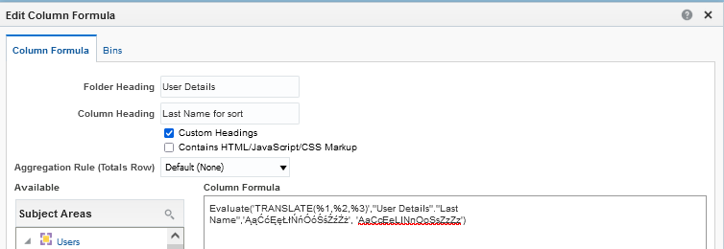
The formula to change the sort (option one)
We will use this
This is the formula we saw earlier
Note that we have called this column “Last name for sort”. We will see why later.

Slide 21
The report with the new formula (option one)

Slide 22

The report with the new formula (option one)
Now we have “Last name for sort” and “First name”.

Slide 23

The report with the new formula (option one)
Let’s also add the “Last Name” (that we originally had and changed to “Last Name for sort”).

Slide 24
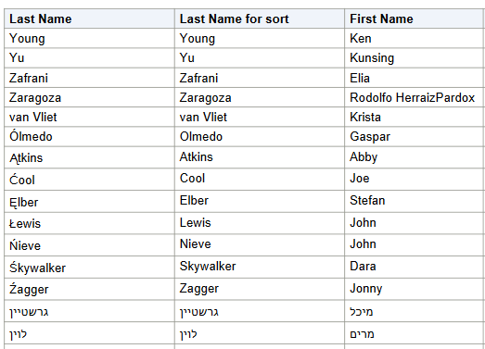
The report with the new formula (option one)
Now we can see that the “Last Name for sort” does not include the diacritics

Slide 25
The report with the new formula (option one)
Now we do not want to display the “Last Name for sort” but we do want to sort by it.
We will sort the report ascending by “Last Name for sort” then we will hide the field.

Slide 26
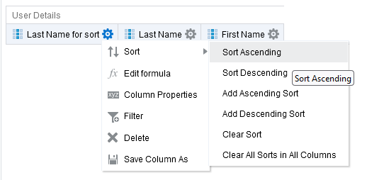
The report with the new formula (option one)
Now we sort

Slide 27
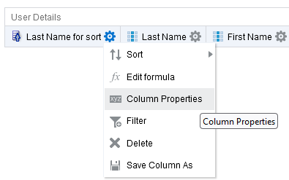
The report with the new formula (option one)
Now we will hide the field (part 1 of 2)

Slide 28
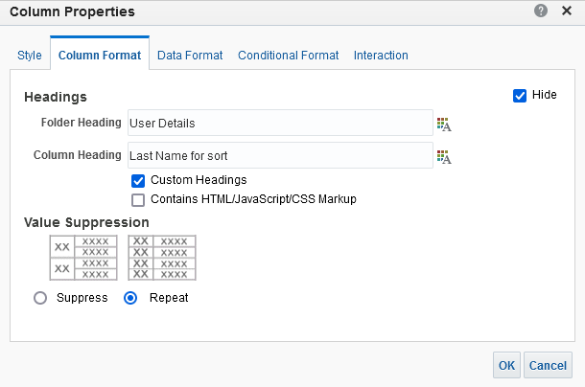
The report with the new formula (option one)
Now we will hide the field (part 2 of 2)

Slide 29
Check the report with the new sorting (option one)

Slide 30
Check the report with the new sorting (option one)
Let’s now take a look at the sorting by last name
We will see that it is all sorting as desired.

Slide 31




Check the report with the new sorting (option one)

Slide 32




Check the report with the new sorting (option one)

Slide 33
The formula to change the sort (option two)

Slide 34
The formula to change the sort (option two)
We will use this formula:
Note that if you copy and paste this formula make sure the quotation marks do not get “ruined”. They may need to be retyped manually.
EVALUATE('CAST(NLSSORT(%1, ''NLS_SORT=POLISH'') AS VARCHAR2(4000))', "User Details"."Full Name")
This means that the sorting will be done as per the standard for the Polish alphabet.
Other languages are available as follows (replace above POLISH with other desired language)
BINARY WEST_EUROPEAN XWEST_EUROPEAN GERMAN XGERMAN DANISH XDANISH SPANISH XSPANISH | GERMAN_DIN XGERMAN_DIN FINNISH FRENCH NORWEGIAN SWEDISH ITALIAN ICELANDIC DUTCH | XDUTCH SWISS XSWISS ARABIC HUNGARIAN XHUNGARIAN GREEK CZECH XCZECH | POLISH SLOVAK XSLOVAK LATIN THAI_DICTIONARY THAI_TELEPHONE TURKISH XTURKISH RUSSIAN | HEBREW LITHUANIAN CROATIAN XCROATIAN ROMANIAN BULGARIAN CATALAN XCATALAN SLOVENIAN | XSLOVENIAN UKRAINIAN ESTONIAN ASCII7 JAPANESE

Slide 35
The formula to change the sort (option two)
In the criteria tab, on the last name, let’s edit the formula

Slide 36
The formula to change the sort (option two)
Instead of this

Slide 37
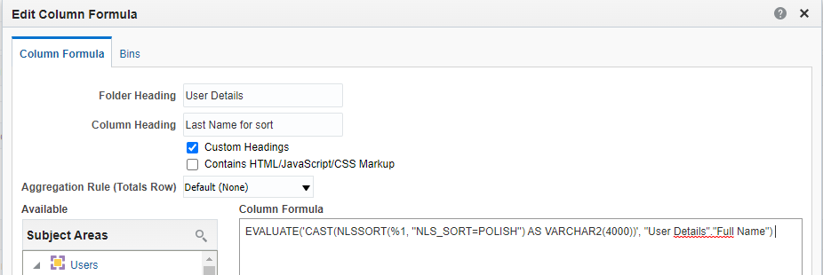
The formula to change the sort (option two)
We will use this
This is the formula we saw earlier
Note that we have called this column “Last name for sort”. We will see why later.

Slide 38
The report with the new formula (option two)

Slide 39
The report with the new formula (option two)
Now we have “Last name for sort” and “First name”.

Slide 40
The report with the new formula (option two)
Let’s also add the “Last Name” (that we originally had and changed to “Last Name for sort”).

Slide 41
The report with the new formula (option two)
Now we can see that the “Last Name for sort” is a series of alphanumeric characters.

Slide 42
The report with the new formula (option two)
Now we do not want to display the “Last Name for sort” but we do want to sort by it.
We will sort the report ascending by “Last Name for sort” then we will hide the field.

Slide 43
The report with the new formula (option two)
Now we sort

Slide 44
The report with the new formula (option two)
Now we will hide the field (part 1 of 2)

Slide 45
The report with the new formula (option two)
Now we will hide the field (part 2 of 2)

Slide 46
Check the report with the new sorting (option two)

Slide 47
Check the report with the new sorting (option two)
Let’s now take a look at the sorting by last name
We will see that it is all sorting as desired.

Slide 48




Check the report with the new sorting (option two)

Slide 49




Check the report with the new sorting (option two)

Slide 50
xxx@exlibrisgroup.com

